Slide 1
Welcome to Virtual Meet the Teacher Night! I am so excited to have your child in my class this year. While I wish we could be together for this night, I have compiled all of the information virtually for you.
Please click the tabs at the top to be directed to information about each topic.
It’s going to be a great year!
Love, Ms. Campbell

Slide 2
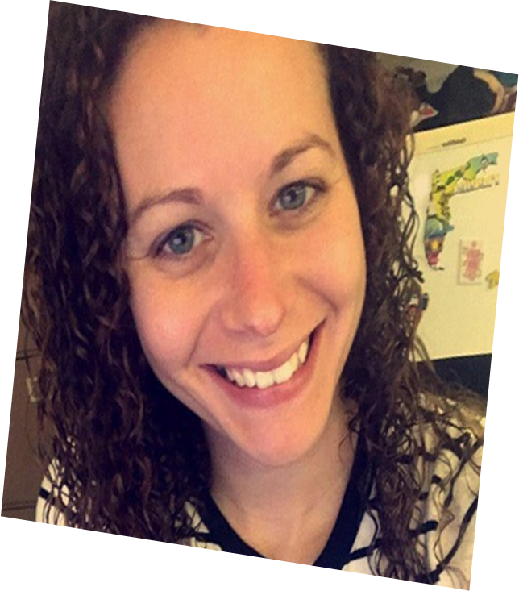
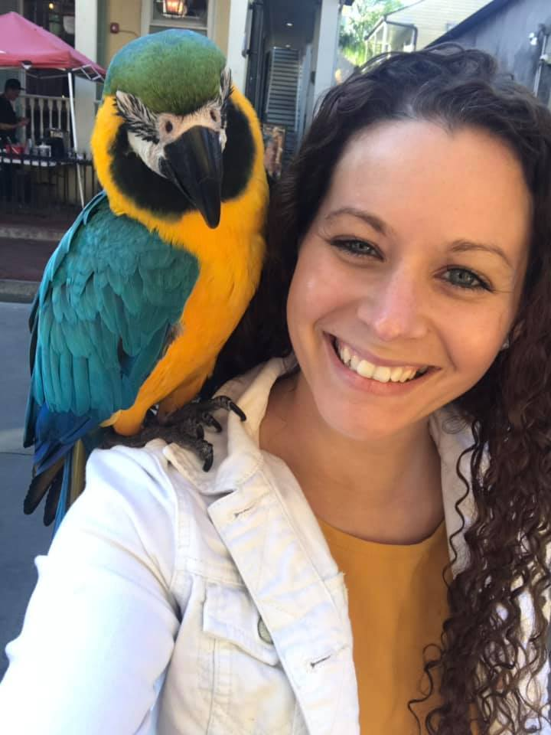
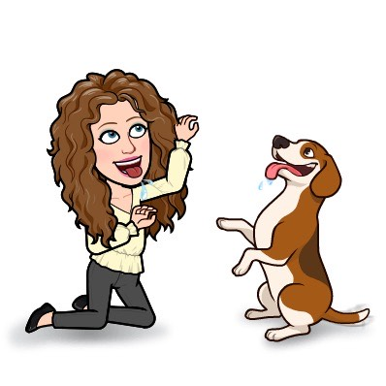
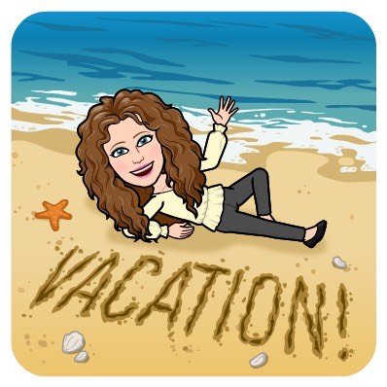
Hi! My name is Ms. Campbell.
I graduated from Flagler college with a degree in Elementary Education and Exceptional Student Education. This is my 4th year teaching at Fort Braden and my 5th year teaching Second Grade.
I have two children who attend Fort Braden in the fifth and second grade.
My favorites include:

Slide 3
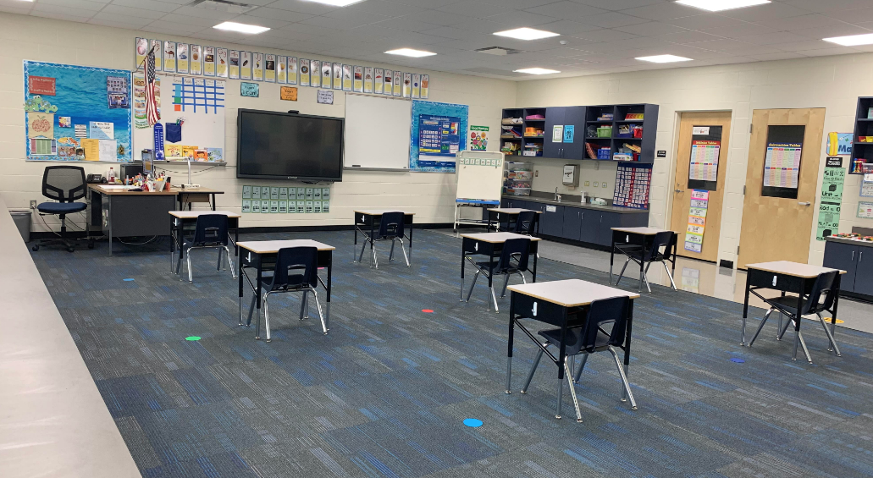
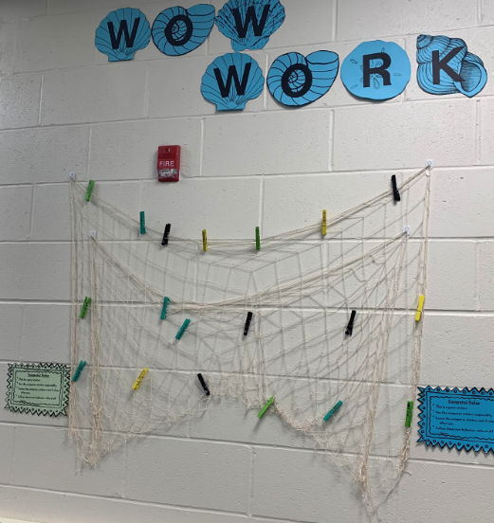
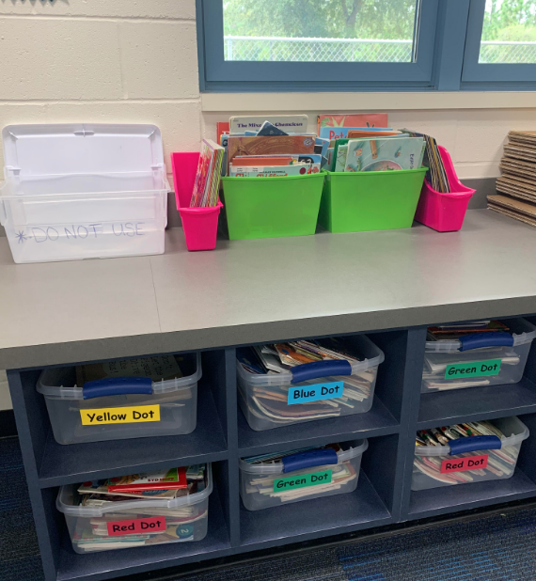
Amazing student work will be hung here for all to see. Wow!
Books will be available for student use in the classroom and quarantined at the end of each week.
Whether you’re tuning in from home or here at school, we are going to have an amazing year together in 2nd grade!!!

Slide 4
Morning Meeting 8:35 – 9:15
Special Area 9:15 – 9:55
Math 9:55 – 11:00
Lunch 11:00 – 11:25
Developmental Play 11:30 – 12:00
ELA 12:00 – 12:30
Mask Break 1:30 – 1:45
Science / Social Studies 1:45 – 2:20
Read Aloud 2:25 – 2:45
Dismissal Begins 2:50
*Schedule subject to change

Slide 5
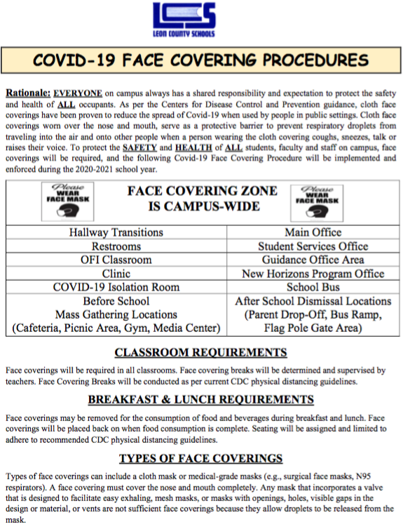
For ongoing updates and detailed info regarding LCS’ response and plans regarding the impact of Covid19, please visit the Covid19 site. HTTPS://WWW.LEONSCHOOLS.NET/COVID19
Additional info about Fort Braden school, Brick and Mortar and Digital Academy can be found on the school’s website.
https://www.leonschools.net/ftbraden

Slide 6
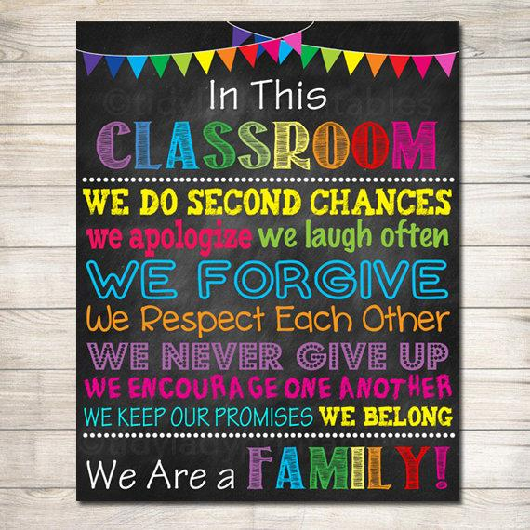
Supply List
Crayons
Markers
Dry Erase Markers
Classroom Wish List:
Clorox/Lysol Wipes
Clorox/Lysol Spray
Hand Sanitizer
Hand Soap
Baby Wipes
Tissue

Slide 7
Contact Information:
E-mail: campbells5@leonschools.net
Phone Number: (850) 488-9374

